Slide 2


Extract Information from Annual Report for Account Opening Purpose
Team: The Booleans

Slide 3


Methodology-Extracting data
Scan through all the JSON files from training folders and select the page IDs which possess entity names.
Count the occurrence time of each words from all the hOCR files with selected entity names.
Delete the most frequent and least frequent words from the word list.
acquisition, 20
amounting, 20
co, 20
.
.
statements, 1201
financial, 1219
audit, 1274
(1, 111), (1, 112), (1, 67) …
… (59, 253), (59,250), (59,253)
inputs
outputs

Slide 4
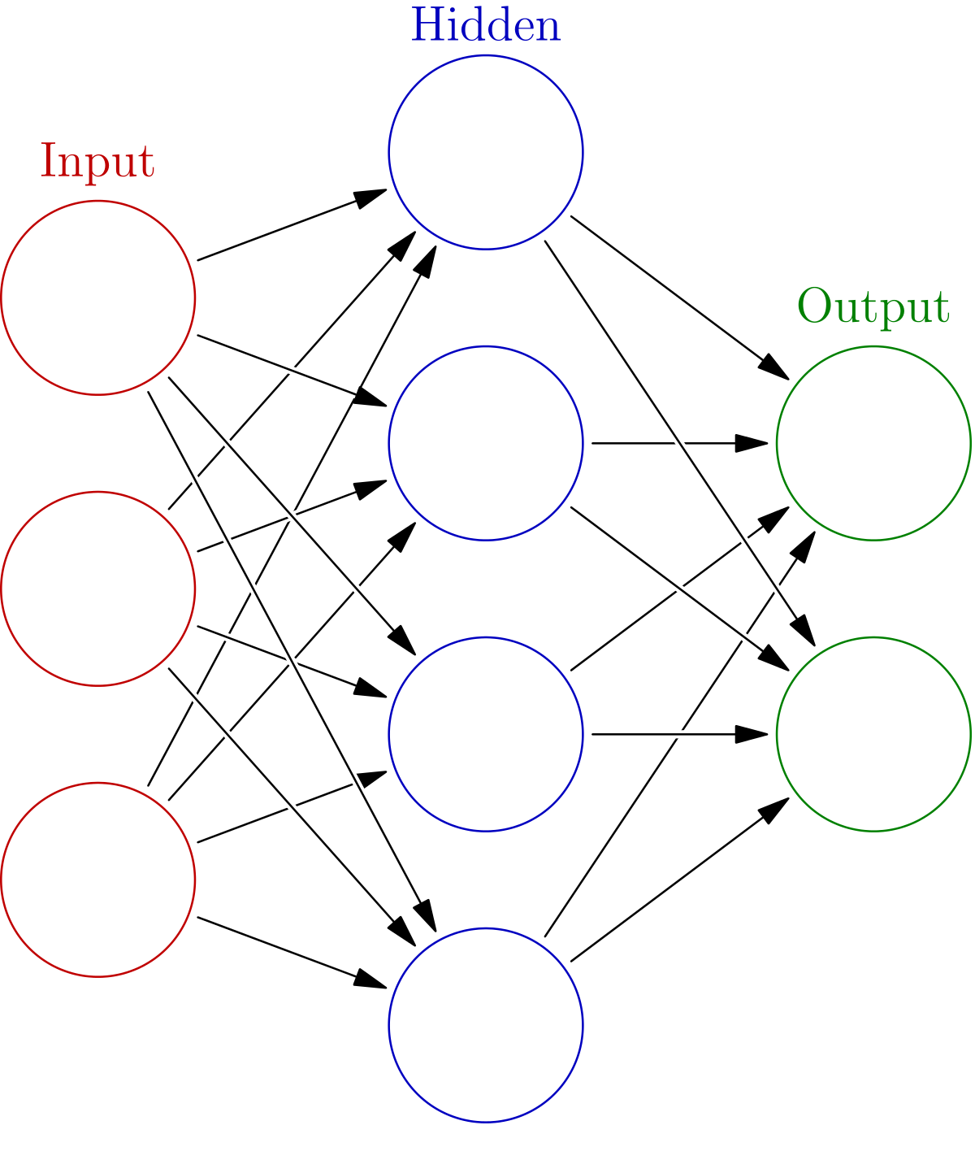
Methodology-Model training
Feed the model with the word list(word + position)
Neural Network structure: 330/16/8/1
256 data points/500 test batches
Each data point is either true or false whether the word from the word list is on the page.

Slide 5
Selection of results
Test type | 1 | 2 | 3 | 4 | avg
50/50 | 0.91 | 0.93 | 0.95 | 0.96 | 0.938
true/true | 0.846 | 0.82 | 0.923 | 0.90 | 0.872
random/overal | 1.0 | 1.0 | 1.0 | 1.0 | 1.0

Slide 6
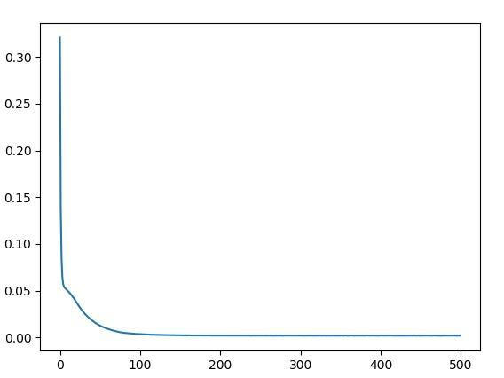
Training efficiency
Error
Time/Iteration

Slide 7
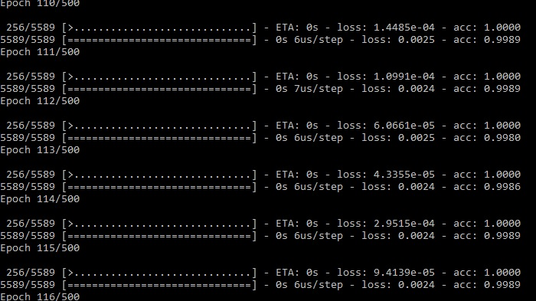

Slide 8
Possible Further Application
Removing non English words

Slide 9
Work distribution
Alex: Neural network training
Jonathan: Prepare training data, interpret the json/hORC data
Ken: Support drafting, Search keyword
Eric: Drafting, Extract data from hOCR
Killian: Support drafting

Slide 10
END

